Slide 1



Making Magic with F# Type Providers
Don Syme, @dsyme
Microsoft Researcher/Architect
F#/.NET Community Contributor

Slide 2
Proposition 1 We are living through an information revolution

Slide 3
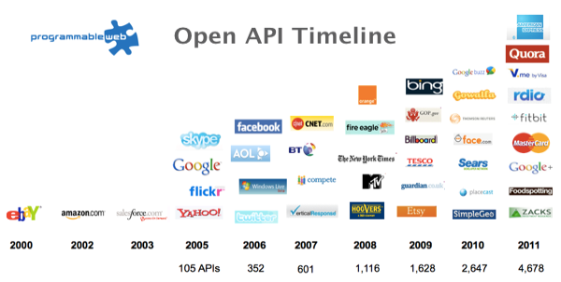
The Information Revolution
2012
2013
6,432
10,537

Slide 4
Proposition 2 Our programming languages are information-sparse

Slide 5
Proposition 3 This is a big problem especially for statically typed languages (Java, C#, F#, VB, …)

Slide 6
We need to bring information into the language… At internet-scale, strongly tooled, strongly typed

Slide 7
Paradigm Locator
Statically Typed
Dynamically Typed

Slide 8
Paradigm Locator
Statically Typed
Dynamically Typed
A major search is on!
make statically typed langs more dynamic
make dynamically typed langs more static
moderate static typing in limited ways

Slide 9
But before we get into that… A bit about F#

Slide 10
F# is free, open source, cross platform, independent fsharp.org Microsoft contribute to F#, and so do many others

Slide 11
The Visual F# Tools from Microsoft are supported, enterprise-ready and come with Visual Studio

Slide 12
F# ad .NET are free, open, cross-platform
The F# Compiler Service = Roslyn for F#
F# 4.0 is under way, please contribute!
Debian and other packages for Linux
The F# language is accepting contributions
fsharp.org
The Visual F# Tools professional tools for Windows/Azure
Xamarin provide F# tools Android and iOS
The Visual F# Power Tools: refactorings and more

Slide 13
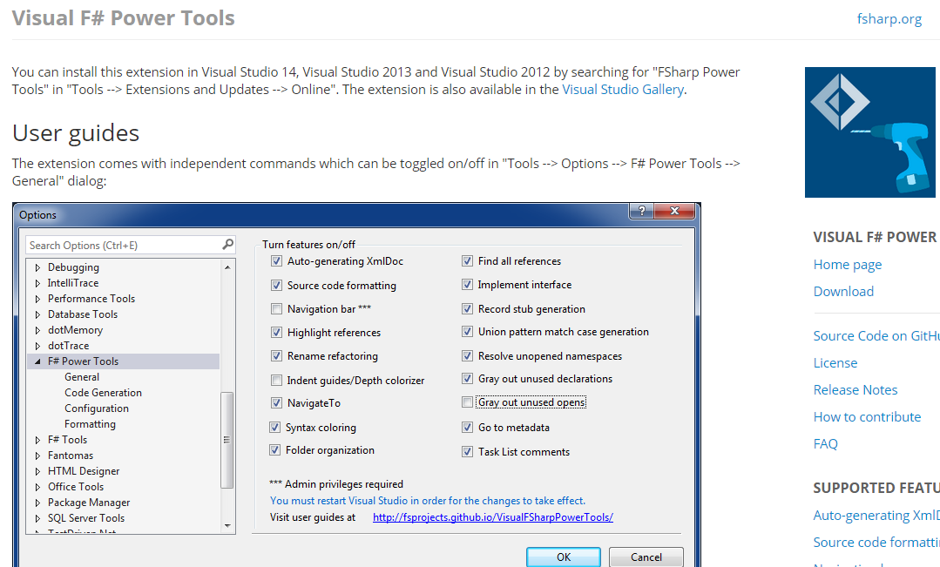

Slide 14
F# is a simple, strongly typed, efficient functional-first language for…. simple code with rich data

Slide 15
F#
C#
let swap (x, y) = (y, x)
let rotations (x, y, z) =
[ (x, y, z);
(z, x, y);
(y, z, x) ]
let reduce f (x, y, z) =
f x + f y + f z
Tuple<U,T> Swap<T,U>(Tuple<T,U> t)
{
return new Tuple<U,T>(t.Item2, t.Item1)
}
ReadOnlyCollection<Tuple<T,T,T>> Rotations<T>(Tuple<T,T,T> t)
{
new ReadOnlyCollection<int>
(new Tuple<T,T,T>[]
{new Tuple<T,T,T>(t.Item1,t.Item2,t.Item3);
new Tuple<T,T,T>(t.Item3,t.Item1,t.Item2);
new Tuple<T,T,T>(t.Item2,t.Item3,t.Item1); });
}
int Reduce<T>(Func<T,int> f,Tuple<T,T,T> t)
{
return f(t.Item1)+f(t.Item2)+f(t.Item3);
}

Slide 16
Understanding the Situation
Analytical Programmers/ Data Scientists
Design
Data Engineers
Code
Analysis
Algorithms
Parallel
Data
Information
Services
Presentation
Publication
UI

Slide 17
Functional-first programming uses functional programming as the initial paradigm for most purposes, but employs other techniques such as objects and state as necessary.

Slide 18
Examples include ETL pipelines, web services, cloud services, data-scripting, calculation engines, programmatic UIs and data science. While these problems can be solved using other programming paradigms, they are particularly amenable to functional-first programming.

Slide 19
Example #1 (power company)
We have written an application to balance the national power generation schedule … for an energy company.
...the calculation engine was written in F#.
The use of F# to address the complexity at the heart of this application clearly demonstrates a sweet spot for the language … algorithmic analysis of large data sets.
Simon Cousins (Eon Powergen)

Slide 20
Example #1 (power company)
Time to Market
Efficiency
Interoperation ... Seamless. The C# programmer need never know.
Units of measure … a huge time saver...it eradicates a whole class of errors…
Exploratory programming …Working with F# Interactive allowed me to explore the solution space more effectively.
Unit testing …a joy to test. There are no complex time-dependent interactions to screw things up….
Parallelism …The functional purity ... makes it ripe for exploiting the inherent parallelism in processing vectors of data.
Code reduction… … vectors and matrices…higher order functions eat these for breakfast with minimal fuss, minimal code. Beautiful.
Lack of bugs… Functional programming can feel strange. .. once the type checker is satisfied that’s often it, it works.
Correctness
Time to Market
Time to Market
Correctness
Correctness

Slide 21
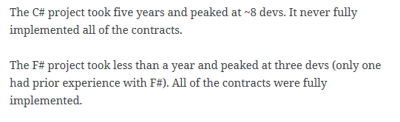
Example #1 (Simon Cousins, Energy Sector)
350,000
lines of C# OO
by offshore team
30,000
lines of robust F#, with
parallel +more features
An application to evaluate the revenue due from Balancing Services contracts in the UK energy industry
http://simontcousins.azurewebsites.net/does-the-language-you-use-make-a-difference-revisited/

Slide 22
Example #1 (Simon Cousins, Energy Sector)
Zero
bugs in deployed system
“F# is the safe choice for this project,
any other choice is too risky”
An application to evaluate the revenue due from Balancing Services contracts in the UK energy industry
http://simontcousins.azurewebsites.net/does-the-language-you-use-make-a-difference-revisited/

Slide 23
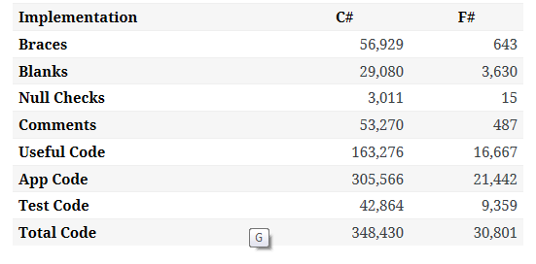

Slide 24
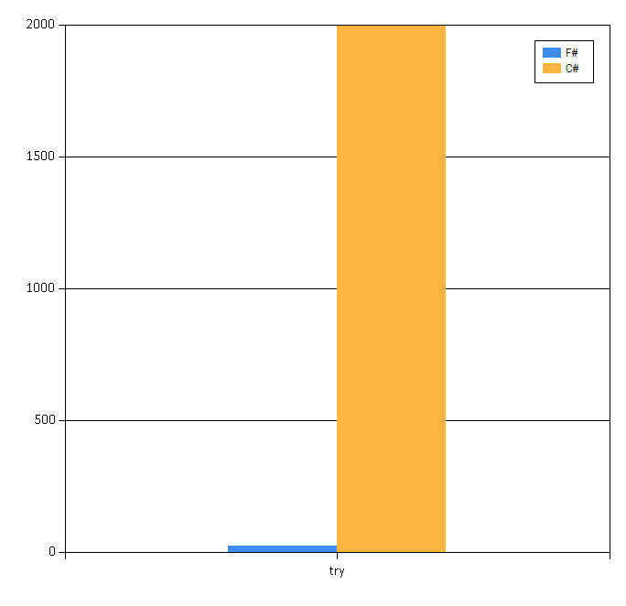

Slide 25
Example #2: F# for Cloud Social Gaming
Efficiency
F# is becoming an increasingly important part of our server side infrastructure that supports our mobile and web-based social games with millions of active users. F# first came to prominence in our technology stack in the implementation of the rules engine for our social slots games which by now serve over 700,000 unique players and 150,000,000 requests per day at peaks of several thousand requests per second.
The F# solution offers us an order of magnitude increase in productivity and allows one developer to perform the work that are performed by a team of dedicated developers on an existing Java-based solution, and is critical in supporting our agile approach and bi-weekly release cycles.
Yan Cui, Lead Server Engineer
Time to Market
fsharp.org/testimonials

Slide 26
10 Reasons Not to Use a Strongly Typed Functional Language

Slide 27
F# is changing…
F# runs on many platforms
“F# is for Windows”

Slide 28
Overview
F# is changing…
“F# has many contributors”
“Microsoft
makes F#”

Slide 29
Overview
F# is changing…
Many perspectives
http://fsharp.org
One perspective
(Microsoft’s)
http://msdn.microsoft.com

Slide 30
F# for Android, iOS, Linux, Mac fsharp.org/use/android fsharp.org/use/ios fsharp.org/use/linux fsharp.org/use/mac

Slide 31
Microsoft recommend F# and the Visual F# tools for your functional-first programming needs ….on all platforms…

Slide 32
Exosystem: Cloud Programming

Slide 33
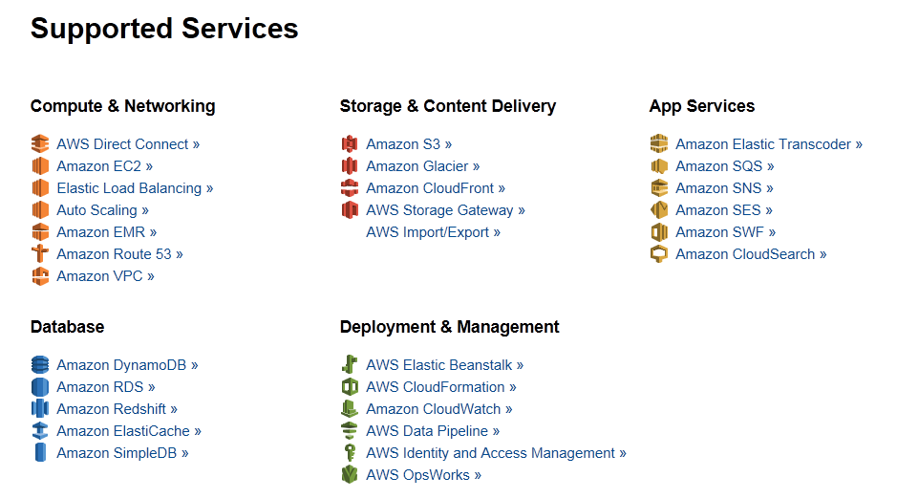
Amazon Web Services .NET SDKs http://aws.amazon.com/tools https://github.com/aws (Apache 2.0)

Slide 34
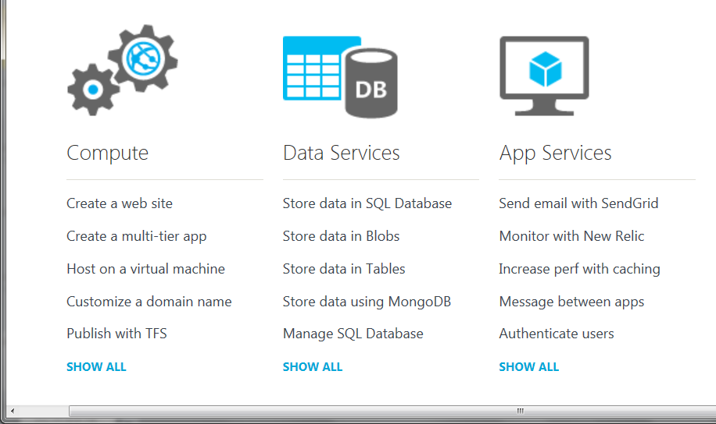
Azure .NET SDKs http://www.windowsazure.com https://github.com/WindowsAzure/ (Apache 2.0)

Slide 35
Back to the main topic…

Slide 36
The Main Topic

Slide 37
You can easily find out more about…
F# Basics
F# + Cloud
F# + DSLs
F# + GPUs
F# +Testing
F# + R
F# + Web
F# + Excel
F# Deep Data Integration

Slide 38

Data is like water…

Slide 39
Data is like water…
Everyone needs it. Everyone knows where to get it.
Nobody is sure where it really came from, or goes to.
…really knows its true cost, or true value.
…likes to pay for it, or to share it.
…knows how much is wasted.
You might get washed away by it.
You only find out it was bad after you have drunk it.

Slide 40

Actually these days it’s more like a flood…

Slide 41
The Problem Our programming tools are data-sparse getting data into a programming language is tiresome, error prone and boring

Slide 42
We need to bring data into the language… At internet scale, strongly tooled, strongly typed

Slide 43
Problem: Integrate all of freebase.com “as if it were a library” >40M entities, >1Billion facts, >24,000 types, >65,000 properties

Slide 44
Demo
F# + Freebase
An F# type provider for deep, robust integration of web data

Slide 45
Demo: F# to WorldBank

Slide 46
A Type Provider is…. “Just like a library” “A design-time component that computes a space of types and methods on-demand…” “An adaptor between data/services and the .NET type system…” “On-demand, scalable compile-time provision of type/module definitions…”

Slide 47
Theme #1 On-Demand Types = Internet Scalable Magic

Slide 48
On-Demand Type Provision
let data = Freebase.GetDataContext()
1. Compiler/IDE requests metadata for symbol GetDataContext
Provider reports return type of FreebaseDataContext
data.
2. Compiler/IDE requests contents of type FreebaseDataContext
Provider asks Freebase metadata service for top-level domains
Provider reports top-level domains of Freebase as properties of the type
data.Society
3. Compiler/IDE requests metadata for symbol Society
...

Slide 49
Theme #2 Applications or Scripts

Slide 50
This is a compile-time feature. You can use it in compiled projects You can use it everywhere, including mobile apps and cloud services To use it from C#, just “right-click, add project, F#”

Slide 51
Theme #3 Many Data Sources, One Mechanism

Slide 52

All your types are belong to us….
types

Slide 53
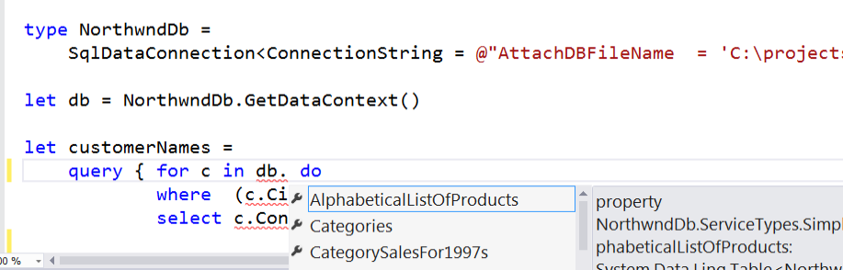
SQL #1

Slide 54
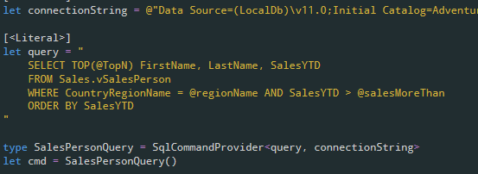
SQL #2

Slide 55
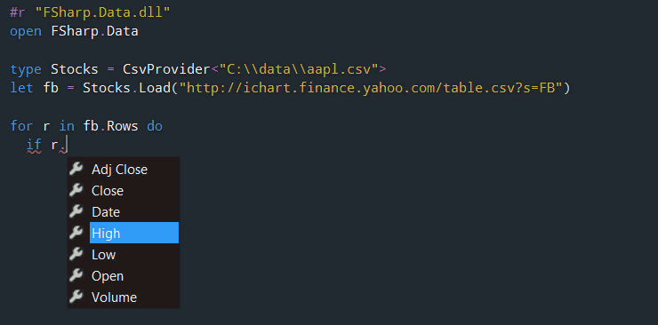
CSV

Slide 56
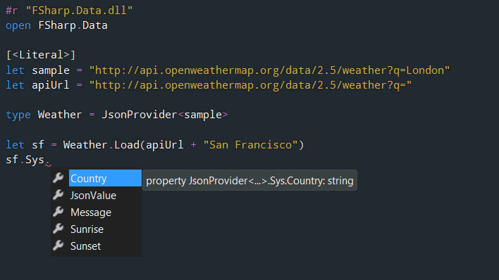
JSON

Slide 57
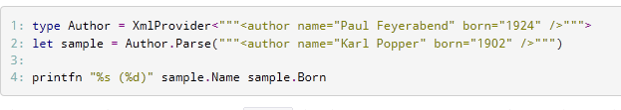
XML

Slide 58
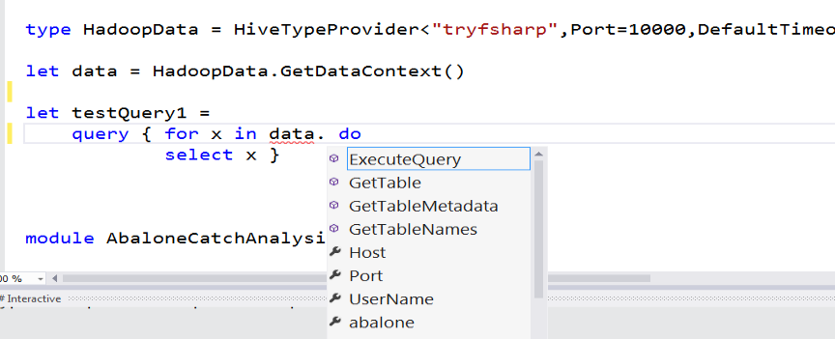
Hadoop/Hive

Slide 59
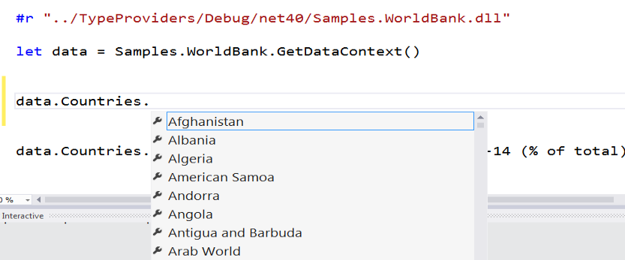
World Bank

Slide 60
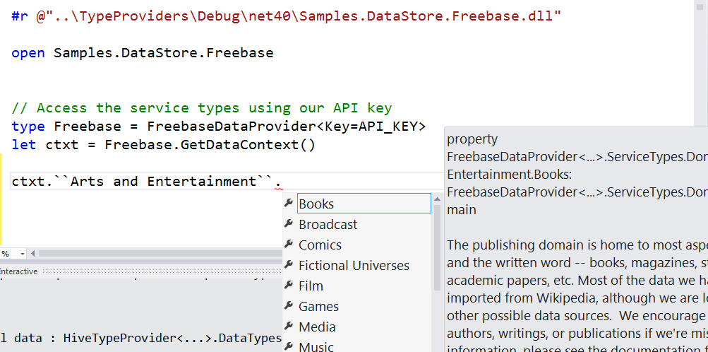
Freebase

Slide 61
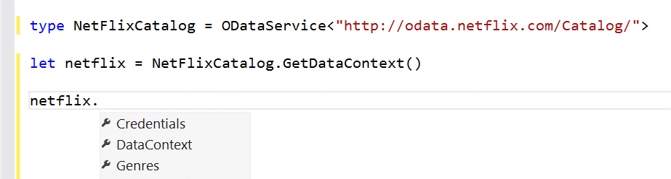
OData

Slide 62
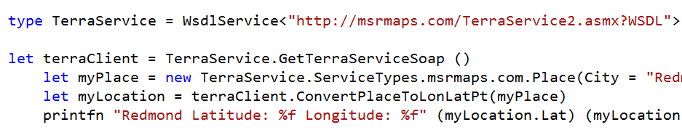
WSDL

Slide 63
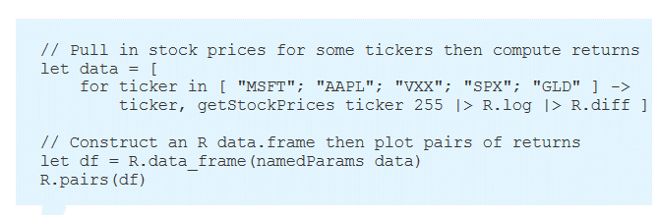
R

Slide 64
Theme #4 Real-world Data, Business Data

Slide 65
Demo
F# + Xenomorph TimeScape video
An F# type provider for deep, robust integration of financial data

Slide 66
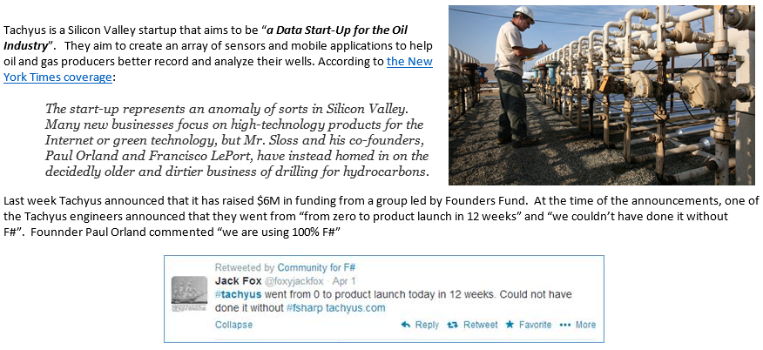
SQL #2 - Application
Correctness
Time to Market

Slide 67
Theme #5 Use with F# Strong Typing

Slide 68
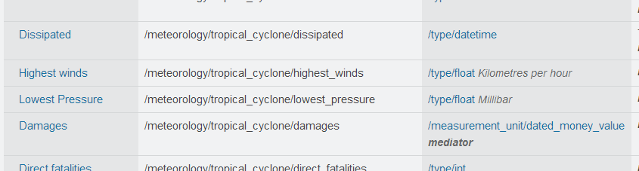
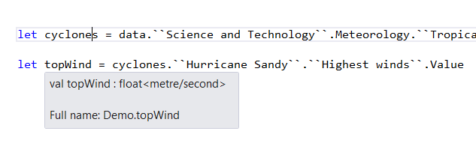
Providing Units of Measure
If the metadata contains units…
via F#’s Units of Measure
…then these can be projected into the programming language.

Slide 69
Getting Started? Get fsharp.github.io/FSharp.Data on NuGet, use it in Visual Studio today

Slide 70
Scalable metadata+data integration is a key challenge for programming today
F# Type Providers are ready for use in production .NET systems

Slide 71
In Summary
F#
The safe choice for enterprise data programming
Unbeatable data integration
Visual F# - tooling you can trust from Microsoft
Open, cross-platform, strongly typed, efficient, rock-solid stable

Slide 72

Questions?

Slide 73
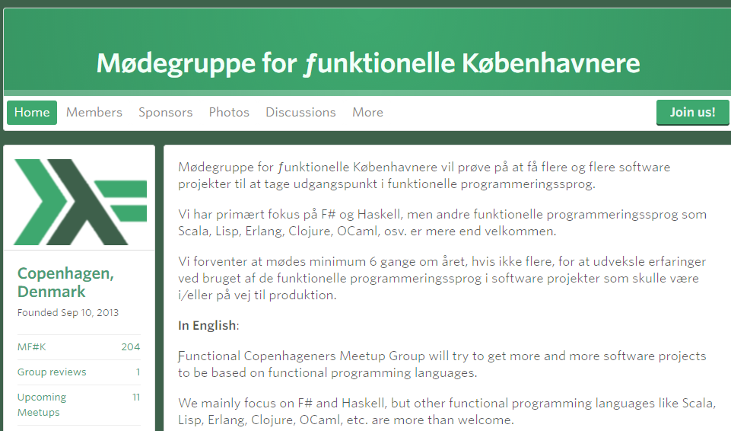
meetup.com/MoedegruppeFunktionelleKoebenhavnere

